Slide 1
Shivaji University, Kolhapur Faculty of Commerce & Management Syllabus as per NEP-2020 (2.0) B. Com. I, SEMESTER – I (Level 4.5) Ability Enhancement Course (AEC-I) English for Business Communication -I (2 Credits = 30 hrs.) Theory 40 Marks & Internal Assessment 10 Marks = 50 Marks) (from June 2024 onwards) Dr. P.S. Sontakke (M.A., M.Phil., Ph.D.)

Slide 2
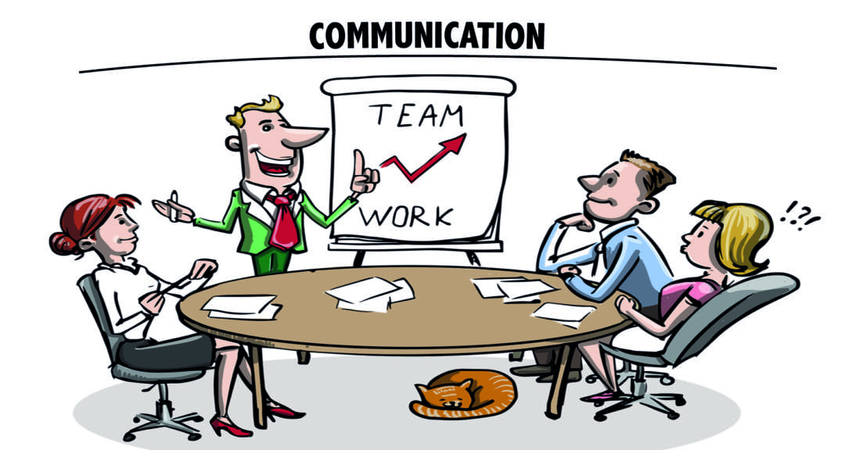

Slide 3
Course Outcomes :
1) To enable students to learn & enrich vocabulary in English
2) To assist students to learn & use present & past tenses
3) To help students to use future aspect
4) To introduce different types of sentence constructions in English
5) To enable students to use new vocabulary in sentences with correct tenses.

Slide 4
Reference Books :
Swan, Michael (2007). Practical English Usage. New Delhi: Oxford University Press.
Rao, Prasad (2019). High School English Grammar & Composition. Delhi: Blackie Books.
Jones, Daniel (2006). Cambridge English Pronouncing Dictionary. Singapore: Cambridge University Press.
https://www.collinsdictionary.com/
Reclaim Your Creative Confidence by Tom Kelley & David Kelley
The Complete Works of Rabindranath Tagore, General Press, New Delhi 2017
2 Credits | 50 Marks (Semester end examination 40 & Internal Evaluation 10) | Total 30 hrs.
Unit No. | Course Content | No. of Hours
Unit-I | Enriching Vocabulary | 15 hours
Unit-II | Tenses & Types of Sentences | 15 hours

Slide 5
Nature of Question Paper
AEC-I: English for Business Communication -I
Internal Assessment: 10 marks
Time: 90 Minutes |  | Total Marks: 40 Marks
Question No. 1 | Multiple Choice Questions (5 questions) | 5 Marks
 | b) Answer in One sentence (5 questions) | 5 Marks
Question No. 2 | a) based on Unit 1 | 10 Marks
 | b) Based on Unit 2 | 10 Marks
Question No. 3 | a) based on Unit | 5 Marks
 | b) Based on Unit 2 | 5 Marks

Slide 6
Unit-I (Hours – 15, Credit – 1)
Enriching Vocabulary (शब्दसंग्रह समृद्ध करणे)
English has now become the language of education, literature, business & everything. Language users all over the world Adapt English as per their general & scientific needs.
Developing communication by using different language skills is first goal of learning English. Vocabulary plays a key role in this process. Without sufficient vocabulary, students can’t understand/express their own ideas.
While expressing emotions/feeling without grammar very little can be conveyed, without vocabulary nothing can be conveyed.

Slide 7
To develop vocabulary, Active (productive) & Passive (receptive) vocabulary are needed.
There are many language learning techniques that are used to develop vocabulary. Some of them are discussed here.
I) Words Classes – open & closed 2) Words Formation Processes – affixation (prefixation & suffixation), blending, compounding …. etc.
3) Synonyms & Antonyms 4) Confusing words 5) Phrasal verbs
A good dictionary is an ideal device to develop vocabulary. It helps us for better understanding of the word with its form, class, usage & pronunciation. Word, phrase, clause & sentence are grammatical units.

Slide 8
To develop vocabulary, function role of the word is very important. Some of the techniques to develop vocabulary are given below.
I) WORD CLASSES : Modern grammarians classify words into two classes - open & closed word classes. Open Word Classes -
Open Word Class | Symbol | Examples
Noun | N | door, bat, tree, fruit …. etc.
Verb | V | play, cut, eat, write …. etc.
Adjective | Adj | clean, big, good, sweet .… etc.
Adverb | Av | quickly, frankly, now, yesterday .. etc.
They are called as open word classes because by adding some particles, we make new words from them. It means that they are infected. They are open ended & called as content words because they carry meaning.

Slide 9
Closed Word Classes :
Closed Word Class | Symbol | Examples
Determiners | d | a, an, the, some, any, all
Pronoun | pn | I, we, you, he, she, it, they, one
Preposition | p | at, in, of, to, above, up, on …. etc.
Conjunction | cj | but, and, or, if, so …. etc.
Operator/helping verb | aux | Can, shall, will, have, may, do, am … etc.
Interjection | ij | Oh, ooh, ugh, hay …. etc.
Enumerator | e | One, two, first, last ….. etc.
They are called as closed word classes because the members in these classes are fixed in no. We can’t make new words from them. It means that they can’t be infected. They are not open ended. They are called as structure words because they are used to build structures. They don’t have definable meaning.

Slide 10
II) WORD FORMATION PROCESSES : This process is the main technique to develop vocabulary. It enriches (समृद्ध) one’s vocabulary. Various processes are used for word formation. One of them is discussed here. Affixation : It is attachment to the root/base of the word. We can form new words by using this process. There are two types of affixation – Prefixation & Suffixation. Prefixation : In this process, an affix is attached before the root/base of the word & new word is formed. There are many prefixes in English.
Prefix | Root/Base | New Word
semi - | Final | Semifinal
re - | Collect | Recollect
un - | Happy | Unhappy
auto - | Biography | Autobiography
de - | Forest | Deforest
multi - | National | Multinational

Slide 11
Suffixation : In this process, an affix is attached after the root/base of the word & new word is formed. There are many suffixes in English –
Suffix | Root/Base | New Word
- al | Arrive | Arrival
- less | Mercy | Merciless
- ness | Happy | Happiness
- ish | Book | Bookish
- ful | Faith | Faithful
- ee | Employ | Employee
III) Synonyms & Antonyms (समानार्थी व विरुद्धार्थी शब्द) : Synonyms are words of same grammatical class having similar meaning. No other word means exactly as any other word. So, synonyms are words having slightly different shades of meaning. Synonyms are words that convey same general idea. Ex – kill, murder, slay, executive, slaughter.

Slide 12
Ex - He was killed in the train accident.
The robbers murdered him & taken away his property.
The soldier was slain on the battlefield.
The criminal was executed.
All the sheep were slaughtered.
Antonyms are the words of same grammatical class but having opposite meaning. Ex – Entry-exit, gain-loss, urban-rural, tall-short, kind-cruel, rise-fall, ascend-descend, accept-reject, etc.
IV) Confusing words or Problem words - Some words in English look alike/sound alike. While using, they confuse for each other. To develop vocabulary, it’s necessary to learn them & to know perfect use of them. Ex – story-storey, suit-suite, enquiry-inquiry.
X X X 0 X X X

