Slide 1
Organs of Speech

Slide 2
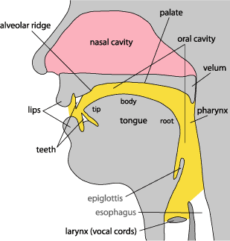
ORGANS OF SPEECH

Slide 3
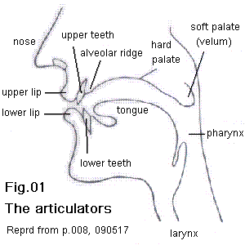
Vocal Cords
Food Pipe

