Slide 1
Description & Classification of Vowels

Slide 2
Vowels are made with an open approximation of the articulators.
The active articulator which is always the front, the back or the centre of the tongue, is raised towards the passive articulator which is either the hard palate or the soft palate or the meeting point between the hard and the soft palates.
As a result, there is a sufficient gap between the two articulators for the air to escape through the mouth without any friction.
The quality of the vowel depends on the shape of the mouth and position of the tongue.

Slide 3
The tongue assumes a number of different positions to produce different vowel sounds but the upper surface of the tongue is usually convex [ ].
This is because some part of the tongue i.e. the front, the centre or the back is raised towards the roof of the mouth.
In English there are 12 pure vowels.

Slide 4
In English there are 12 pure vowels.
I)
Classification of Vowels According to the Part of the Tongue Raised Towards the Palate:

Slide 5
1. Front Vowels:
In the production of front vowels, the front of the tongue is raised in the direction of hard palate.
e.g. / i:, ɪ, e, æ /
e.g. Phonetic Transmission of Words having front vowels:
these - /ծɪz/, bit - /bɪt/, bread - / bred/, lamp - /læmp/

Slide 6
2. Back Vowels:
In the production of back vowels, the back of the tongue is raised in the direction of soft palate.
e.g. / u:, ʊ, ɔ:, ɒ, ɑ:/
e.g. Phonetic Transmission of Words having back vowels:
tube - /tju:b/, book - /b ʊ k/, all - / ɔ:l/,
hot - /h ɒ t /, smart - /smɑ:t /

Slide 7
3. Central Vowels:
In the production of central vowels, the centre of the tongue is raised in the direction of centre of palate.
e.g. / ʌ , ɜ:, ə /
e.g. Phonetic Transmission of Words having central vowels:
bus - / b ʌ s /, girl - / ɡ ɜ:, l /, ajar- / ədʒɑ: /

Slide 8
II) Classification of the Vowels according to the Shape of the Lips / Mouth:
1. Rounded: Here, the lips are brought forward
as for the vowel /u:/.
2. Unrounded: Corners of the lips are pulled back
as for the vowel / i: /.

Slide 9
Classification of Vowels According to the Height of the Tongue to which the Tongue is Raised Towards Palate:
III

Slide 10
1. Close Vowels:
In the production of close vowels the part of the tongue is raised very close to the roof of the mouth. As in /i:/
2. Half – Close Vowels:
In the production of half-close vowels the part of the tongue is raised between close and open but nearer to close than open. As in /ɪ /.

Slide 11
3. Open Vowels:
In the production of Open vowels, the part of the tongue is far away from the roof of the mouth. As in /ɑ: /.
4. Half Open Vowels:
In the production of half open vowels, the part of the tongue is raised between close and open but nearer to open than close. As in /æ /.

Slide 12
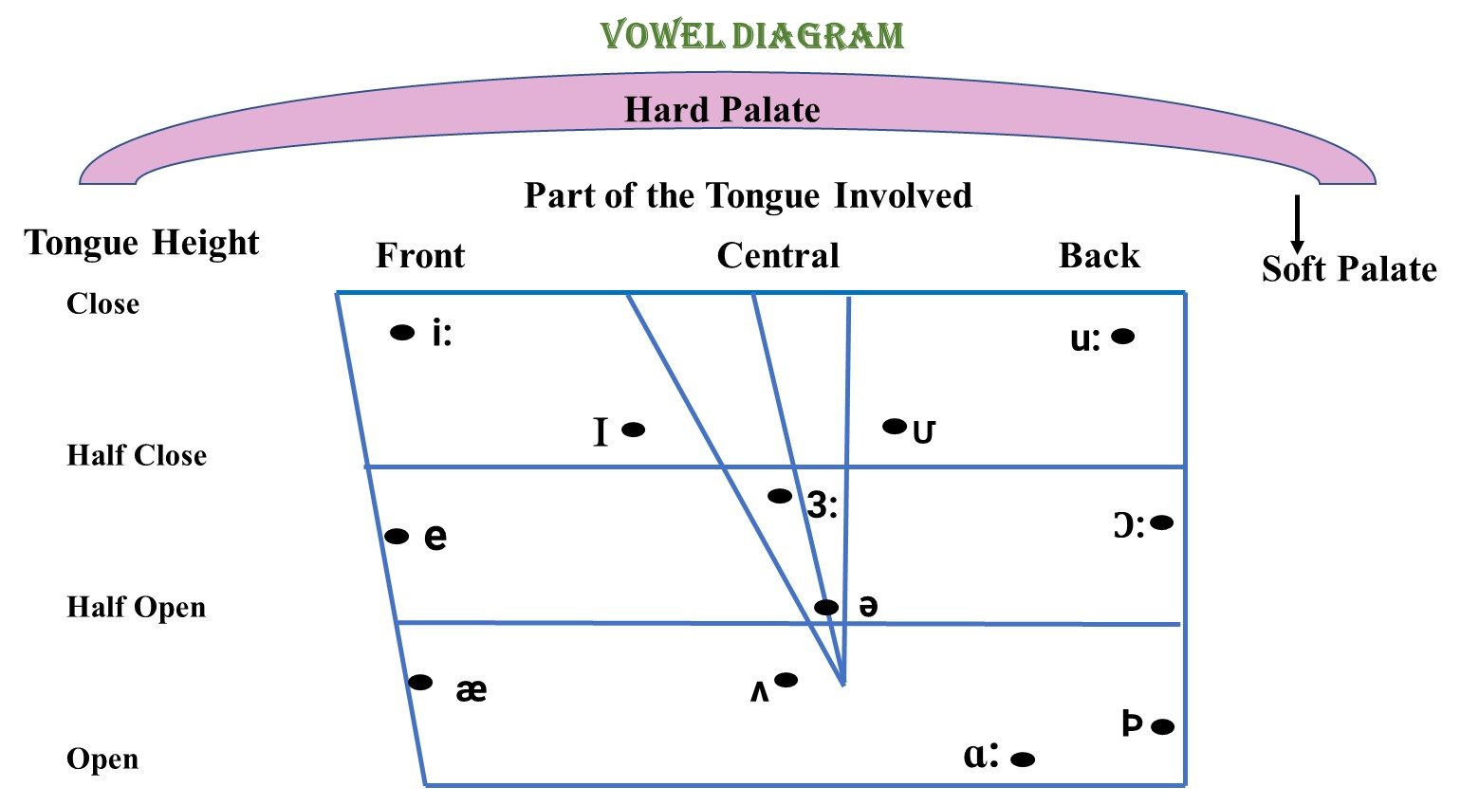

Slide 13
Three Term Labels of English Vowel Sounds:
Sr. No. | Vowel | Part of the Tongue Raised | Height of the Tongue Raised | Shape of the Lips
1. | / i: / | Front | Close | Unrounded
2. | / ɪ / | Front | Half Close | Unrounded
3. | / e / | Front | Between Half Close and Half Open | Unrounded
4. | / æ / | Front | Just Below Half Open | Unrounded
5. | / u: / | Back | Close | Rounded
6. | / ʊ / | Back | Between Close and Half Close | Rounded
7. | / ᴐ: / | Back | Half Close and Half Open | Rounded
8. | / ɒ / | Back | Open | Rounded
9. | / ɑ: / | Back | Open | Unrounded
10. | / ə / | Central | Between Half Close and Half Open | Unrounded
11. | /3:/ | Central | Between Half Close and Half Open | Unrounded
12. | / ʌ / | Central | Between Open and Half Open | Unrounded

