Slide 1
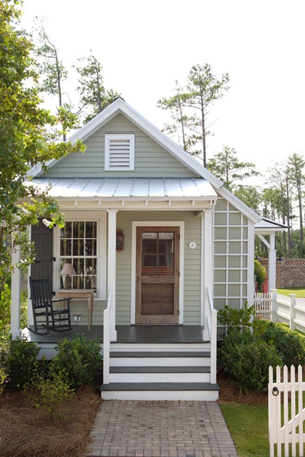
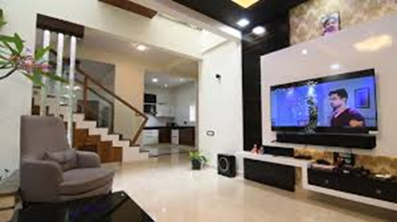
Mahila Mahavidyalaya, Karad Department of Home Science
Welcome to
B.A. II Semester 3
Home Science Paper III
Dr. Ila Jogi
Head, Department of Home Science

Slide 2
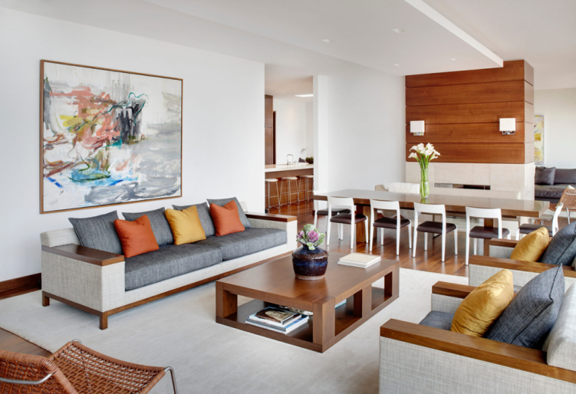
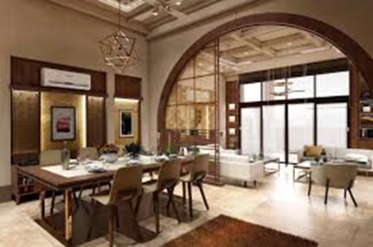
Paper III: Basics of Interior Design
Module 1:Basics of Interior Design
1.1 Elements of Arts
1.2 Principles of Design
1.3 Application of elements and
principles of design in Interior
Decoration

Slide 3
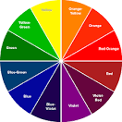
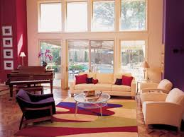
Module 2: Colour
2.1 Colour- Definition and Importance
2.2 Dimensions of colour
2.3 Classification of colour
2.4 Colour schemes and Harmonies/
Effects of colour
Link: https://www.youtube.com/watch?v=-GHlQqIzWas

Slide 4
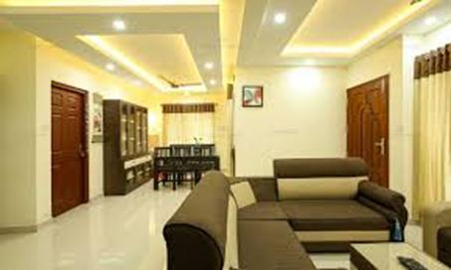
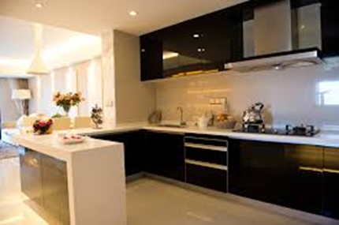
Module 3: Furniture Arrangement
3.1 Importance and Types of Furniture
3.2 Selection of Furniture
3.4 Care of furniture
3.4 Furniture arrangement in different rooms

Slide 5
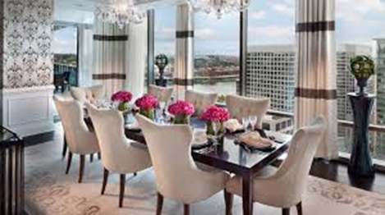
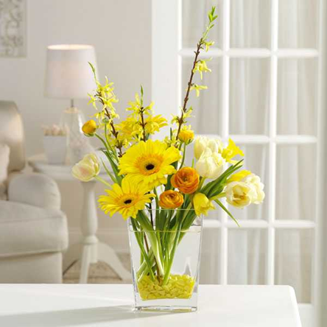
Module 4: Flower arrangement and Flower Decoration
4.1 Importance of Flower Arrangement and Flower Decoration
4.2 Material used for Flower Arrangement and Flower Decoration
4.3 Types of Flower Arrangement and Flower Decoration

Slide 6
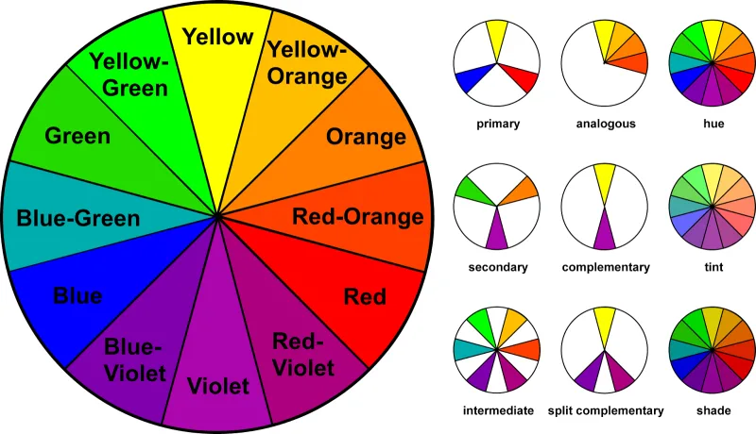
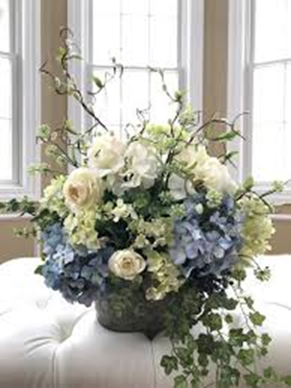
Practical
1. Preparation of Primary, Secondary and Tertiary colour and Colour wheel
2. Preparation of colour scheme
3. Preparation of Colour Hue
4. Demonstration and Preparation of Types of Flower arrangement
5. Demonstration and Preparation of Types of Flower decoration
6. Visit to Furniture shop/Mall/Manufacturing unit

