Slide 1
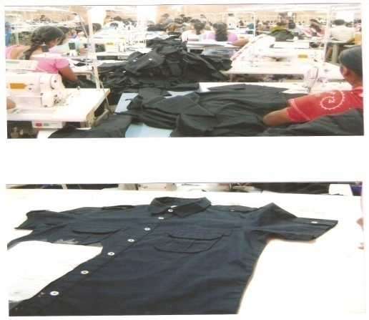
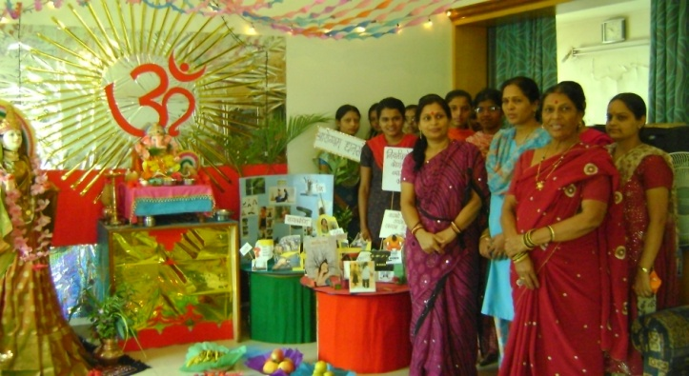
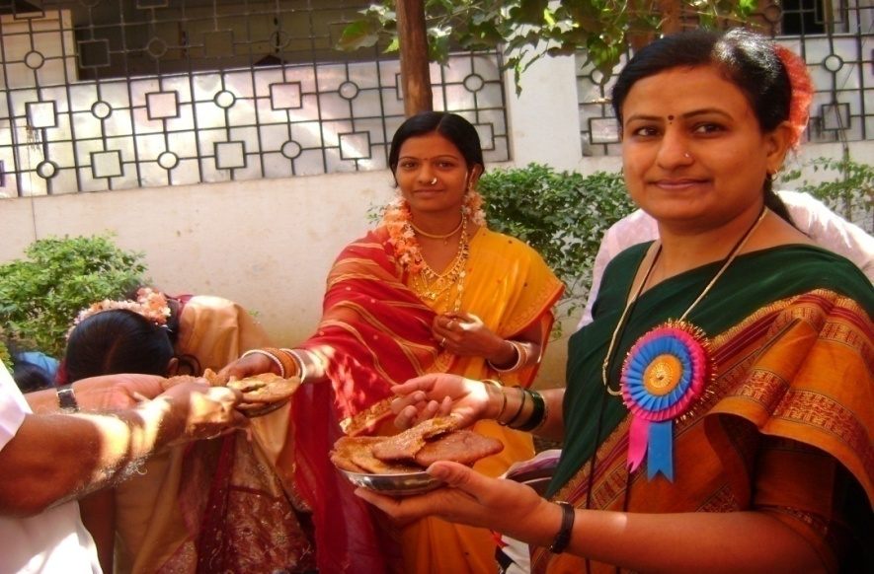
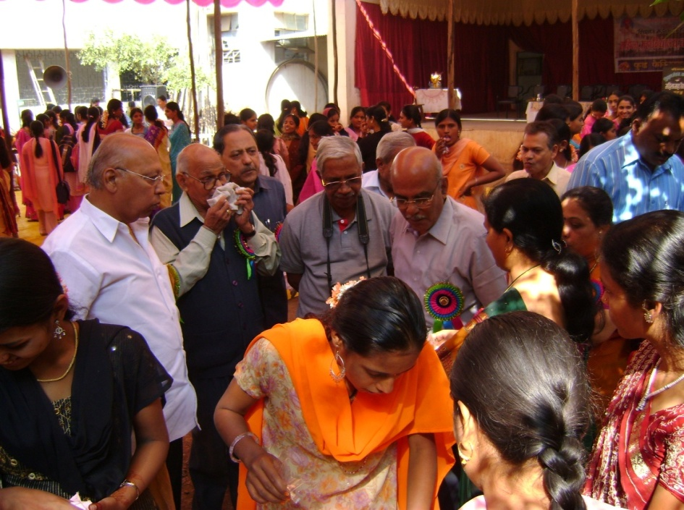

Slide 2
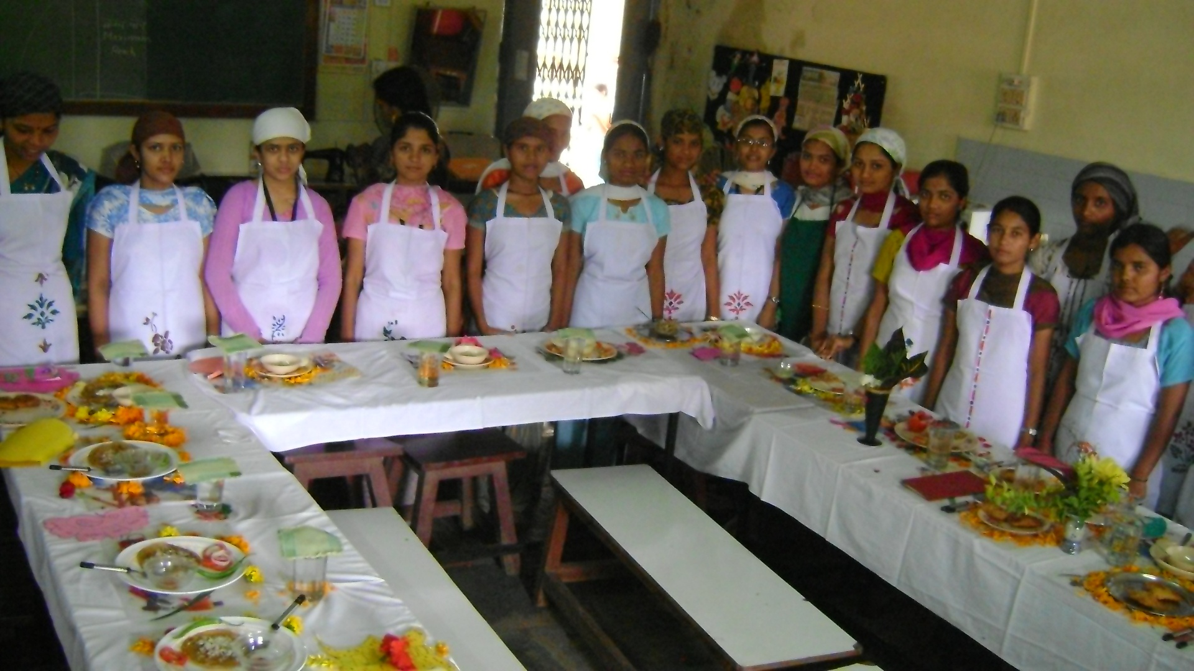
Home SCIENCe
Home Science means art of managing ones
resources efficiently and the science of achieving a
healthier, happier home and if need be, a career.

Slide 3
Home Science is the science of the home which is concerned with the maintenance and enrichment of human relationship through development and judicious use of all available human and material sources. Home Science aims to develop women personally and professionally. Home Science is not just about educating women to be experts of home decoration. The subject is largely scientific in nature and requires analytical mind and scientific temper.
Home Science

Slide 4
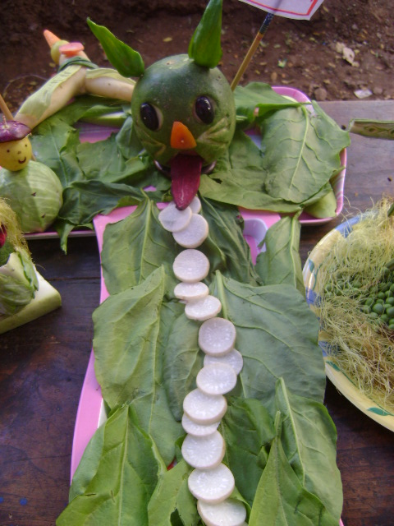
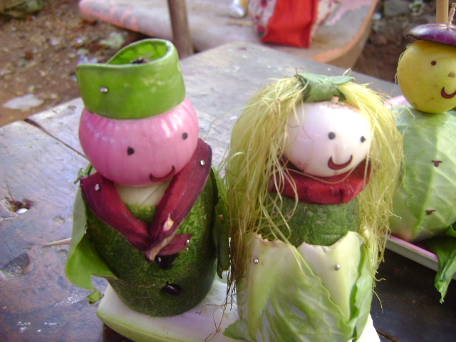

Slide 5
It is a holistic field that aims to develop women personally and professionally.
The goal of Home Science is to enable students to be successful homemaker, entrepreneurs and educationist.

Slide 6
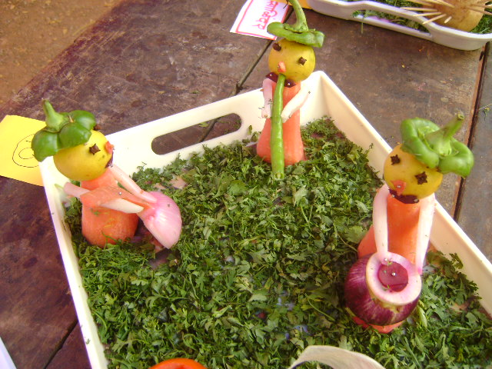
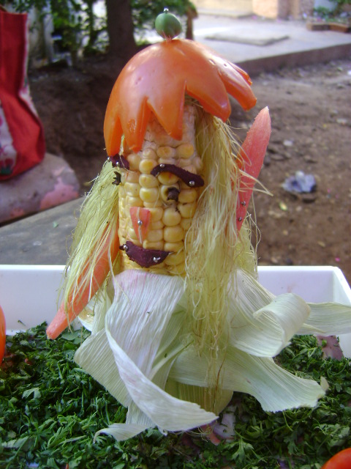
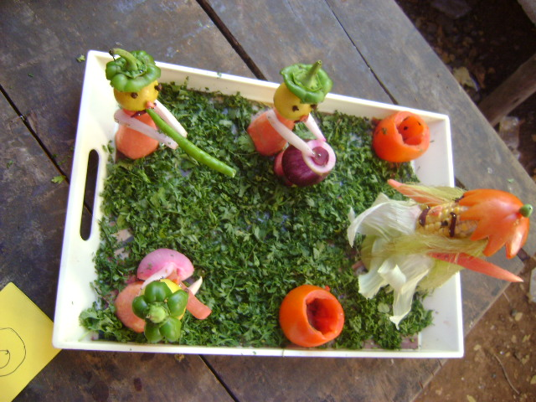
Salad Decoration Competition

Slide 7
Home Science is the field of knowledge and services primarily concerned with strengthening family life and enhancing potentials of the individual for meaningful living through : TEACHING : Educating the individual for family living. Improving the services and goods used by families. RESEARCH: Conducting the research to discover the changing needs of individual and families and the means of satisfying these needs. EXTENSION : Furthering community, national and worldwide conditions favourable to family living.
HOME SCIENCE

Slide 8
Home Science synthesizes knowledge drawn from its own research, from the physical, biological ,social sciences and the arts and applies this knowledge to improving the lives of families and individuals.

Slide 9
Objectives
Be efficient homemakers, dutiful mothers and purposeful citizens.
Develop a sense of responsibility in their homes.
Lead happy and contented lives within their means.
4. Adjust between demands of home and career.
5. Cultivate good responsibilities at home, school and society.
6. Appreciate dignity of labour.
7. Form good health habits.

Slide 10
8. Develop self reliance and confidence.
9. Get equipped with all the skills necessary to manage a home.
10. Promote aesthetic appreciation in daily life.
11. Develop spirit of civic consciousness.
12. Learn ways and means to supplement family income.
13. Plan for leisure time and recreation.

Slide 11
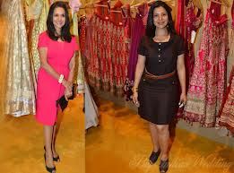
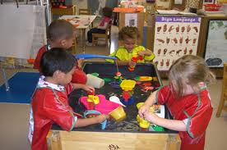
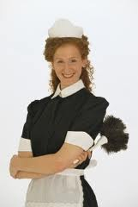
Disciplines of Home Science
Food and Nutrition
Textiles and Clothing
Family Resource Management
Child/Human Development
Home Science Extension Education

Slide 12
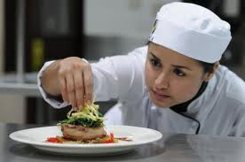
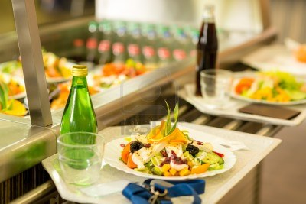
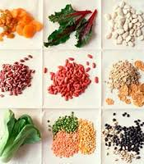
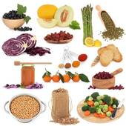
Food and Nutrition Catering
Wage Employment
1. Manager
2. Cook
3. Waiter
Self Employment
As a owner of
1. Canteen
2. Cafeteria
3. Restaurant
4. Dhaba
5. Tea shop
6.Contract of catering order
7.Management of catering centre
8. Organisation of hobby classes

Slide 13
Food Preservation
Wage Employment
Production manager
Production Supervisor
Assistant in Quality Control Dept.
In charge of Community Canning Centre
Instructor of Community Canning Centre
Self Employment
As a Owner of
Food Processing unit
Advisor of Food Processing Unit
Organisation of Hobby centres – jam, Jelly making, cake, pastry making etc.

Slide 14
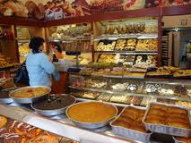
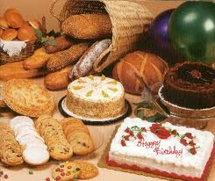
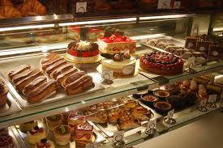
Baking and Confectionary
Wage Employment
Worker in Bakery
Supervisor in Bakery
Manager in Bakery
Self Employment
As a Owner of
Bakery
Organiser of Hobby Classes : Biscuits, cake making

Slide 15
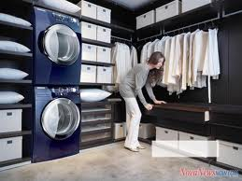
Family Resource Management
Wage Employment
Housekeeper
Caretaker
Supervisor in Laundry
Home Caretaker
Manager in Laundry
Self Employment
As a Owner of
Guest House
Take on Contract management of offices, commercial complexes, shops, etc.
Laundry
Organiser of Hobby Classes

Slide 16
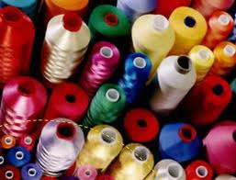
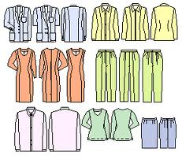
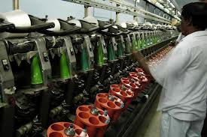
Textile and Garment Designing
Wage Employment
Managers in Mills
Managers in Mills
Dress Designer
FINISHERS
Cutter
Pattern Maker
Tailor
Self Employment
As a Owner of
Designing of Dress
Boutique
Take a contract of school uniform
Manufacturing of garment designing
Dress making shop
Pattern maker
Organiser of Hobby Classes

Slide 17
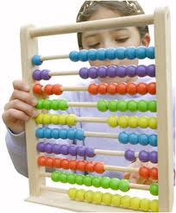
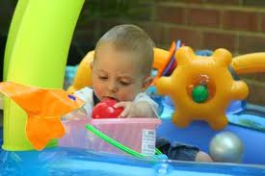
Child/Human Development
Wage Employment
Anganwadi Worker
Anganwadi Supervisor
Balwadi Supervisor
Nursery Teacher
Nursery Instructor
Principal of school
Counselor in Special School
Self Employment
As a Owner of
Creche
Balwadi
Nursery School
School for Special Children
Old Age Care Home / Day Care Centre
Organiser of Hobby Classes

Slide 18
Communication and Extension Education
Wage Employment
Social Worker
Counsellor
Project officer
Researcher in Community
Self Employment
As a Owner of
Non Govt. Organisation
Develop Enterprise and Generate income
Counselling Centre for Vulnerable group
Create trust, society for needy population

Slide 19
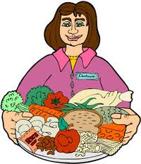
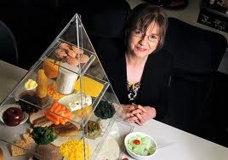
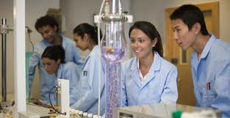
Dietician Lecturer Reader Researcher in National Institutes, Research Centres

Slide 20
Activities of Home Science Department 1. Short term Courses in Home Science 2. LPG Safety Clinic 3. Food Festival 4. Health Check up of the students 5. Essay Competition 6. Dental Check up of the students 7. Lectures of eminent faculties 8. “Kitchen Queen” competition in collaboration with Bharat Gas Service 9. Workshop on “Flower Decoration and Arrangement”

Slide 21
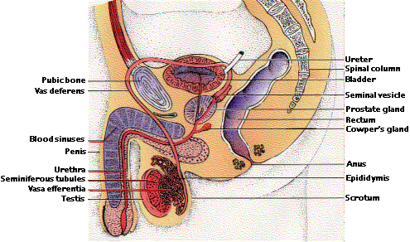
Male Reproductive System

Slide 22
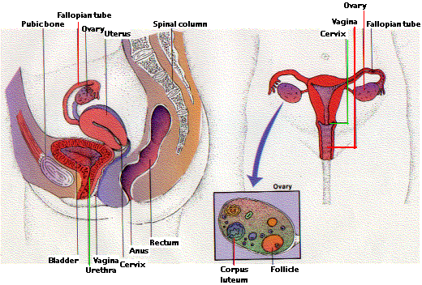
Female Reproductive System

Slide 23
Menstrual cycle
Females of reproductive age (anywhere from 11-16 years) experience cycles of hormonal activity that repeat at about one-month intervals. (Menstru means "monthly"; hence the term menstrual cycle.)
Menstruation refers to the periodic shedding of the uterine lining or refers to the discharge of blood and mucus from the uterus. It occurs in the women from puberty till menopause, at regular intervals of about a month. The average menstrual cycle takes about 28 days .The time at which menstruation first begins in girls is said as menarche. It corresponds to the period of puberty. The release of the egg cell to the outér end of uterine tube is called ovulation. Ovulation occurs midway of every menstrual cycle. The actual age at which cycles occur varies according to individuals’ race, climate, social conditions health etc. In India most girls begin to menstruate between the ages of 9 and 14yrs. The duration of the cycle is 5 days.

Slide 24
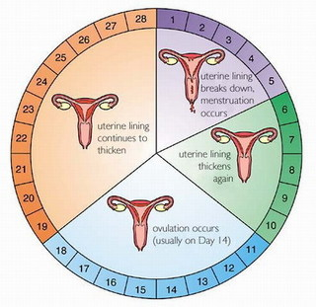

Slide 25
Changes during puberty:
Puberty is a time when there are a lot of changes in the girl not only physically but also in the way she feels.
Some of the physical changes that may occur are, changes in height or growth in weight, breasts, the body produce more sweat giving out a body odour, hair growth under the arms, on legs and in the pubic area and vaginal discharge begins. The onset of menstrual cycle is the biggest change in a girl during puberty. Psychological changes such as an increased shyness ,feeling of reserve and awakening of sexual feelings are experienced.
Many girls are worried that cycles are irregular at the beginning. But this is normal. It takes a while for the body to settle, which could be a few years after which the cycles will be regular.
Periodic headaches and general upsets of health , stomach pain are common.
Many girls have cramps like feeling in the abdominal area, backache, they can relieve by keeping a hot water bag, taking bath in warm water and doing some gentle exercises.
Many of the girls get anxious because of pimples. This is only natural because of the hormonal changes occurring in the body. But some basic care can be taken to minimize the same.

Slide 26
Care during menses
Regular cleansing of face with a cleanser. Care should be taken that face is not washed too many times because the skin tends to react and this produces more oil. Pimples should not be squeezed. Any good medicated soap or lotion has antibacterial properties that proves more useful than other products to reduce pimples.
According to certain religion having a bath during menstrual cycles is not acceptable. But nowadays with girls being an active participant in academic as well as other extra curricular and sports activities, following these sentiments would be unhealthy. Having a body wash twice a day during periods is advisable.
In the olden days women would use cloth pad which was not enough protection. It could be embarrassing as it could be smelly, sometimes could leak and stain and of course unhealthy, as dampness of the cloth could result in microbial growth.
Today we have other alternatives one of which is using sanitary pads. It is more hygienic and comfortable to use. But care has to be taken with pads too. They should be changed regularly. One should always clean the hands with soap after using them. It should be disposed in a safe manner by wrapping it in a paper and putting them in the waste bins.
Last but not the least many young girls at this age are very keen to stay slim and skip their lunch or breakfast. It is very essential to have a proper balanced diet during these growing years.

Slide 27
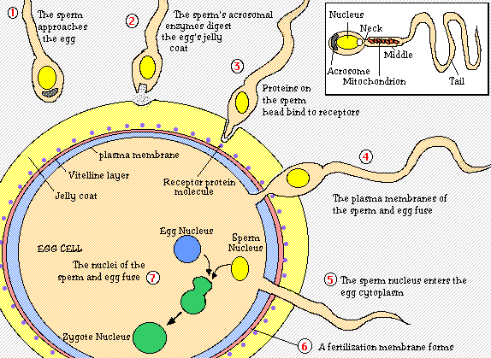
Conception

Slide 28
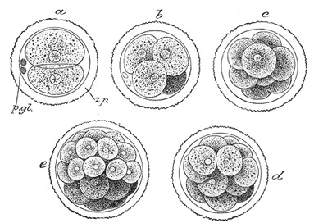
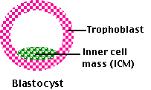

Slide 29
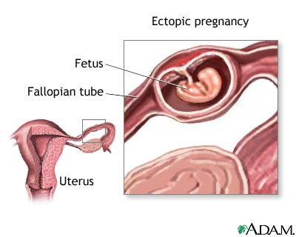

Slide 30
Adolescence :
Adolescence is a period of rapid growth: up to 45% of skeletal growth takes place and 15 to 25% of adult
height is achieved during adolescence (Rees and Christine, 1989).
During the growth spurt of adolescence,
up to 37% of total bone mass may be accumulated (Key and Key, 1994).
Nutrition influences growth
and development throughout infancy, childhood and adolescence; it is, however, during the period of
adolescence that nutrient needs are the greatest (Lifshitz, Tarim and Smith, 1993).

Slide 31
Changes during Adolescence
Changes in height, weight and body composition
during adolescence
The time and tempo of changes in height, weight and body
composition can vary greatly between and among adolescents.
Changes in height
• 15-20% of adult height is gained during adolescence.
• Growth spurt starts later in boys than girls and has a higher peak
velocity than in girls. Linear growth can be slowed or delayed in
adolescence if diet is severely restricted in energy or energy
expenditure is increased as in highly competitive athletes.
Changes in weight
• 25-50% of final adult ideal weight is gained during adolescence.
• The timing and amount of weight gain can be greatly affected by
energy intake and energy expenditure.

Slide 32
Changes in body composition and skeletal mass
• In the pre-pubertal period the proportion of fat and muscle in
boys and girls is similar, and lean body mass is equal in both
sexes.
• Growing boys gain proportionately more muscle mass than fat,
and more lean body mass as compared to girls.
• As adults the normal percentage of body fat is about 23% for
women and 15% for men.
• Approximately 45% of skeletal mass is added during adolescence.
By the end of the second decade of life, 90% of total bone mass
is gained.
• Females with delayed puberty fail to gain bone mass at a normal
rate and show lower mineral density as adults. Nutrition is one
of the environmental factors that determines onset of puberty.
• The pubertal growth can be monitored by using height-for-age,
weight-for-age and body mass index (BMI)-for-age (weight/
height2).

Slide 33
Children normally have a growth spurt during their adolescent years (12 to 18 years old).
A healthy diet for most adolescents is one that provides enough nutrients for growth.
A healthy diet also has the right amount of nutrients to keep an adolescent healthy and keep him from having health problems.
A poor diet may lead to health problems such as anemia (decreased oxygen going to body tissues), eating disorders, or obesity (being overweight).
A poor diet may cause other health problems later in life such as obesity, heart disease, or diabetes.
Regular physical activity can lower your child's risk of having some of these health problems

Slide 34
A healthy diet for adolescents should include different kinds of foods from all the food groups.
Meals should have enough protein (such as meat, beans and nuts) to help your child grow.
Meals should also have carbohydrates (kahr-bo-HI-drayt) (bread, pasta and cereal), fruits, and vegetables.
Meals should also include dairy products such as milk and cheese.
The kinds of foods your child eats should be high in vitamins and minerals.
Your child's diet should also be low in fat and sugar.
Eating foods that are low in fat and sugar can help your child stay at a healthy weight, and decrease his risk of health problems.

Slide 35
What foods should be avoided eating and drinking?
Don’t eat a lot of fast food and convenience foods.
These foods are high in fat and sugar. Some examples of fast foods and convenience foods are hamburgers, french fries, pizza, potato chips, candy and soda. These high fat, high sugar foods may replace healthy foods if your child eats or drinks them too often. For example, adolescents may drink a lot of soda and not drink any milk.
Your child may not get enough calcium if he does not drink milk or eat other dairy foods.
High fat, high sugar foods may also cause your child to eat too many calories. Eating too many calories may cause your child to become overweight.
Plan and pack healthy foods if your child eats meals and snacks away from home.

Slide 36
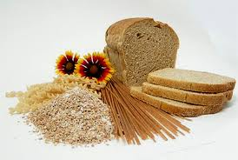
What should adolescent eat and drink for a healthy diet?
Breads, cereal, rice, and pasta:
Eat six to eleven servings each day.
One slice of bread, small roll, or 6-inch tortilla.
One-half of a cup of cooked cereal, rice, or pasta.
One-half of a hamburger bun, English muffin, or bagel.
Three to four small crackers.
One ounce or about one-half of a cup of ready-to-eat cereal.
Vegetables:
Eat three to five servings each day.
One-half of a cup of cooked or chopped, raw vegetables.
Three-fourths of a cup of vegetable juice.
One cup of leafy green raw vegetables such as lettuce or spinach.

Slide 37
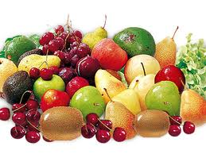
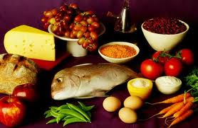
Fruit:
Eat two to four servings each day.
One whole fruit such as a medium banana, apple, or orange.
One melon wedge, one-fourth of a melon, or one-half of a grapefruit.
Three-fourths of a cup of fruit juice.
One-half of a cup of berries, or one-fourth of a cup of dried fruit.
One-half of a cup of chopped or canned fruit.
Milk, yogurt, and cheese:
Eat three servings each day.
One cup of milk.
Eight ounces of yogurt.
One and one-half ounces of natural cheese.
Two ounces of processed cheese.

Slide 38
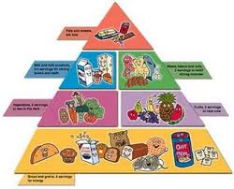
Meat, poultry, fish, dry beans, eggs, and nuts:
Eat two to three servings each day. One serving equals two to three ounces of a protein food such as:
Two to three ounces of cooked lean meat, poultry, or fish.
Two teaspoons of peanut butter.
One egg (eating two eggs counts as one serving).
One cup of cooked dry beans.

Slide 39
What are some other guidelines for a healthy diet?
Your child still learns from your eating habits.
Take a healthy diet by setting a good example.
Buy healthy foods for your family.
Encourage to eat regular meals and snacks even if he is busy.
Eat healthy meals together as a family as often as possible.
You may also need to help to plan your meals and snacks by packing a lunch.
You could also suggest that eat at restaurants that have healthy food choices.
Praise good food choices whenever you can.

Slide 40
Adolescents may want to follow a new fad diet (popular diet) if they see their friends or famous people following these diets.
These diets may not have all the nutrients your child needs to grow and stay healthy.
Dieting too often may also lead to eating disorders such as anorexia nervosa and bulimia nervosa. Anorexia nervosa is refusal (not wanting) to eat. Bulimia nervosa is binge eating followed by throwing up, using laxative medicine, fasting (not eating at all) or heavy exercise.
You should talk with your child about the reasons why eating a healthy diet is important. Talk with your caregiver if you are worried about your child's eating habits.

Slide 41
Risks:
Adolescents who do not eat a wide variety of foods are at risk of not getting enough nutrients.
Many adolescents eat foods that are high in fat and sugar very often.
High fat, high sugar foods may cause your child to become overweight or have other health problems.
High fat, high sugar foods may also cause your child to not get enough nutrients.
Dieting too often may cause adolescents to develop eating disorders such as anorexia nervosa and bulimia nervosa.

Slide 42
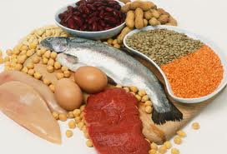
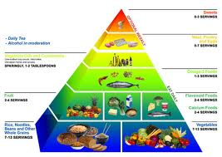
Normal Requirements :
Calories- females require 2200 Cal./day and males 2500-3000.
Protein- females 0.8g/kg/d males 1.0g/kg./d (30% of caloric intake) weight lifters only 1.6-1.7 mg/kg/d. Many teens meet or exceed this level, including vegetarians.
Fats- 30% of daily calories. Most adolescents get enough fats. Teenagers should be taught to read labels and learn about fat content of foods.

Slide 43
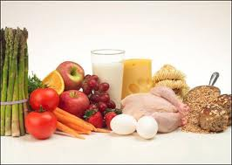
Zinc- 12-15 mgs/day. Found in meats, eggs, seafood, and dairy products
Fiber-20-25 grams/day. Found in fruits, vegetables, grains, beans, and cereals.
Vitamins-most commonly adolescents are deficient A, B6, E, D, C, and folic acid. Usually, adolescents who are eating normal daily requirements of nutrients are not deficient in vitamins. Vitamin supplements may be added to meet requirements.
Vitamin D – 400 IU/day. Found in fortified milk and cereal, egg yolks. Prevalence of deficiency is 14%; 20 times higher in non-Hispanic, black adolescents, twice as high in females and inversely related to weight (using the definition of vitamin D deficiency as a serum level of 25-hydroxy vitamin D <20 ng/mL)

Slide 44
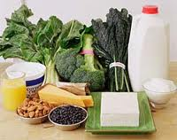
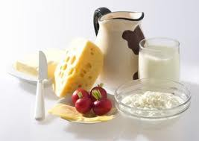
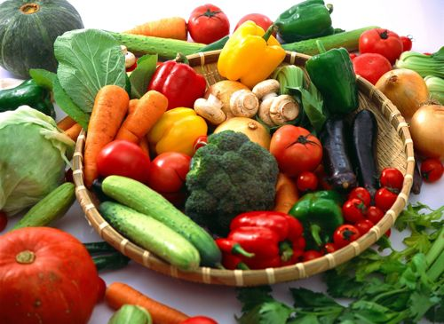
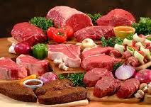
Calcium- The majority of bone mass deposition occurs during adolescence. Daily requirement 1500 mg/day. Sources include dairy products, calcium enriched orange juice, green leafy vegetables, sardines, soymilk, tofu or antacid tablets.
Iron- requirements are high during adolescence because of growth. Requirement higher in menstruating females. Good sources include meats, green vegetable, cereals fortified with iron, fish, poultry, eggs, and nuts

Slide 45
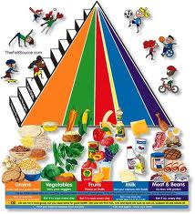
Overall diet: Fewer than 2% of adolescents consume enough fruits and vegetables. Intake of fruits and vegetables should total 3.5-6.5 cups per day. Adolescents should have 3 cups of skim/fat free milk per day. Sugar-sweetened drinks should be avoided as they displace more nutrient rich sources from the diet and 500 kcal per day of sugar-sweetened drinks is equal to 50 pounds per year. The AAP recommends limiting fast food consumption as a way to prevent obesity.

Slide 46
TIME MANAGEMENT
In this universe of abundant time, our time is still finite. God has allotted equal time to wealthiest and to the poorest, leaders and their followers, presidents and commoners.
Benjamin Franklin said ‘Time is money’. This is an under-statement. In fact, time is more than money. While money can be saved, time can not be saved for the future.
As we go up in our life the demand for our time would keep on increasing; however, its supply would be static.

Slide 47
The wealth and income of each one of us may go up and vary from person to person yet the time available to each one of us would remain static and exactly the same. i.e. 24 hours a day. While money lost can be recovered through special efforts, time lost is lost for ever.
Time can multiply money but money cannot multiply time.
We can however gain some time with money by delegating some work to others.
Let us therefore, manage our most precious asset in the most prudent way.

Slide 48
We can start managing our time by adopting the following practices:
Let us focus on results, not on activities.
Let us plan to do what is important rather than what is urgent most of the time.
Let us keep a diary and a ‘To Do’ list for each day- in order of priority.
Let us time our activities.
Let us learn to complete each job satisfactorily the very first time.
Let us choose our words judiciously, to be effective communicators. (Miscommunication causes maximum wastage of time).

Slide 49
Let us write everything in the right place in the very first time.
Let us have a place for everything and let’s make its place closet to where it is used.
Let us label everything.
Let us have a very efficient filling system for all our papers and records.
Let us learn to delegate effectively all the work which can be done by others.
Let us to learn to say ‘no’ without offending people.

Slide 50
Let Us Manage Our Lives Through Time Management
Since time management is life management, managing time is as complex as life itself.
To realize the value of one year: Ask the student failed his final exam.
To realize the value of one month: Ask the mother who has given birth to a one month premature baby.
To realize the value of one week: Ask the editor of the weekly newspaper.

Slide 51
To realize the value of one day: Ask the daily wage earner who has 10 mouths to feed.
To realize the value of an hour: ask the lovers who are waiting to meet.
To realize the value of a minute: Ask the person who has missed the train, the bus, or the plane by a minute.
To realize the value of a second: Ask the person who has survived an accident.
To realize the value of a millisecond: Ask the person who has won only a silver medal in the Olympics, missing the gold.

Slide 52
Life Time Goals
The first step in setting personal goals is to consider what we want to achieve in our lifetime (or, atleast in next five years) as setting Lifetime Goals give us an overall perspective that shapes all other aspects of our decision making.
To give a broad, balanced coverage of all important areas in our life, let us try to set goals in some of these categories (or in categories of our own, where these are important to us):
Education:
Is there any knowledge in particular we want to acquire? What information and skills will we need to achieve other goals?
Career:
What level we want to reach in our career?

Slide 53
Financial:
How much we want to earn and by what stage?
Physical:
Are there any athletic goal we want to achieve, or we want good health deep into old age? What steps are we going to achieve these?
Family:
Do I want to get married? If so, how I am going to be a good partner? How do I want to be seen by a partner or by member of my extended family?

Slide 54
Attitude:
Is any part of my mindset holding me back? Is my behaviour (or part of it) upsetting me or others? If so, let me set the goals to improve my behaviour or find a solution to the problem.
Pleasure:
How we want to enjoy our life? We should ensure that a good part of our life is for us?
Public Service:
Do we want to make world a better place? If so, how?

Slide 55
Let us spend some time brainstorming these and then select one goal on each category that best reflects what we want to do. Then consider trimming again so that we have a small number of really significant goals on which we can focus.
As we do this, make sure that the goals that we set are the ones that we genuinely want to achieve, not the ones that our parents, family, teachers or employees might want (If we have a life partner, we should also consider that what he or she wants; however we should make sure that we also remain true to ourselves).

Slide 56
Let Us Start Working On Our Lifetime Goals
Once we set our lifetime goals, set a 10 year plan of smaller gols that we would complete if we are to reach our lifetime plan. Then let us set 5 year plan and 1 month plan of progressively smaller goals that we would reach to achieve our lifetime goals. Each of these should be based on the previous plan.
Then let us create a list of things that we should do today to work towards our lifetime goals.
Finally, let us keep on reviewing our plans and make sure that they fit the way in which we want to live our life.

Slide 57
Staying On Course
Once we have decided our first set of plans, keep the processes going by reviewing and updating our to-do list on a daily basis. Periodically let us review the long term plans, and modify them to reflect our changing priorities and experience

Slide 58
Goal Setting Tips
State each Goal As A Positive Statement:
Let us express our goal positively. To become an effective public speaker let us say to ourselves – ‘Feel confident while speaking’.
Let Us Be Precise:
Set a precise goal, putting in dates, times and amounts so that we can achievement. If we do this, we will know exactly when we have achieved the goal and can take complete satisfaction from having achieved it.
Let Us Set Priorities:
When we have several goals, let us give each such goal a oriority rating. This helps us to avoid feeling overwhelmed by too many goals, and helps to direct our attention to the most important ones.

Slide 59
Let Us Write Down Our Goals:
This crystalise them and gives them more force.
Let us Keep Operational Goals Small:
Keep low level goals we are working towards small and achievable. If a goal is too large, then it can seem that we are not making progress towards it. Keeping goals small and incremental give us more opportunities for rewards.

Slide 60
Let Us Set Performance Goals, Not Outcome Goals:
We should take care to set goals over which we have as much control as possible.
There nothing much depressing than failing to achieve a personal goal for reasons beyond our control.
In business, there could be bad business environment or unexpected effects of government policy.
In sport for example, these reasons could include poor judgement, bad weather, injury or just plain bad luck.
If we base our goals on personal performance, then we can keep control over the achievement of our goals and draw satisfaction from them.

Slide 61
Let Us Set Realistic Goals:
It is important to set goals that we can achieve.
All sorts of people (employers, parents, media, society) can set unrealistic goals for us. They will often do this in ignorance of our desires and ambitions.
Alternatively we may set goals that are too high, because we may not appreciate either the obstacles in the way or understand quite how much skill we need to develop to achieve a particular level of performance.

Slide 62
Achieving Goals:
When we have achieved a goal, take the time to enjoy the satisfaction of having done so.
Absorb the implications of goal achievement, and observe the progress we have made towards other goals.
If a goal is a significant one, let us reward ourselves appropriately.
All this helps us build the self-confidence we deserve.

Slide 63
With the experience of achieving this goal, let us review the rest of goals:
If we achieved our goal too easily, make us make other goals harder.
If a goal take a dispiriting length of time t achieve, let us make the other goals a little easier.
If we learn something that would lead us to change other goals, let us do so.
If we notice a deficit in our skills despite achieving the goal, decide whether to set goals to fix this.

Slide 64
Failure to meet these goals does not matter much, as long as we learn from it.
Remember too that our goals will change as time goes on. So let us adjust them regularly to reflect growth in our knowledge and experience, and if goals do not hold any attraction any longer, then let us drop them.
Goal Setting is an Important Method of :
Deciding what is important for us to achieve in our life.
Separating what is important from what is irrelevant, or a distraction.
Motivating ourselves and
Building our self confidence, based on successful achievement of goals.

Slide 65
Let Us Try To Fill Our Day with What Is Important Rather Than Urgent
Urgent And Important
Repairing of vehicles
Telephone Repair
Electricity Repair
TV/Cable Repair
Preparing for forthcoming marriage of a family member
Resumption of water supply
Attending the marriage of someone close
Attending a funeral/cremation/condolence meeting
Replying business e-mail
Learning the intricacies of new job

Slide 66
11.Understanding the functioning of new machine
Inoculation of children
12.Visiting a dentist when having a toothache
13. Meeting the boss for some important instructions
14. Rushing to help someone who has met with an accident
15. Visiting a patient in hospital who is serious and critical.
16. Depositing insurance premiums
17. Buying gifts for an immediate event
18. Booking a cinema/railway/air/bus ticket
19. Sanitary fitting repair
20. Filling of income tax returns

Slide 67
Important But Not Urgent
House construction
Visiting someone in hospital who has been recovering
Learning a language
Pursuing a hobby
Replying friends emails
Buying life insurance policies
Learning meditation and pranayam
Undertaking regular medical check-ups
Coaching children
Meeting relatives or close family within the city
Getting the car serviced
Upgradation of office computer
Reading good book

Slide 68
Urgent But Not Important
Attending a phone call (Some of the calls may not be important)
Attending the visitors or strangers who have no serious business with us
Submitting the reports that may be required but not important
Meeting called by the boss in which your presence may not be necessary

Slide 69
Neither Urgent Nor Important
Gossiping
Reading glossy magazines
Shopping for fun
Watching the whole of a cricket match (Live)
Taking unnecessary interest in other’s personal matters
Channel surfing on T.V.
Watching movie that has already been watched
Internet surfing
Visiting friend and neighbours aimlessly
Making lengthy telephone calls aimlessly

Slide 70
Let Us Focus On results, Not Activity
Sometimes we take satisfaction from the endless activities we are engaged in and feel happy about our constant dynamism. But, at the end of the day, when we look at the end result of all the activities, there is no much to be pleased with. It appears that we have been busy doing with nothing.
A wise time manager delegates the routine and less important work to his team members and tries to focus on the more important tasks.
And a still wiser executive is the one who delegates even the more important tasks to his juniors and focuses on the most crucial decisions and problems.

Slide 71
We need to start any task with an end in mind. For example, reading a book is an activity and the end result is delight, knowledge or enhancement of our ability;
Jogging is an activity and keeping fit or reducing weight could be its end result;
Meditation may be an activity and it could be aimed at improving one’s mental and spiritual health.
While undertaking any activity, we should ask ourselves the question: ‘Why am I undertaking this activity?
By getting an honest answer to this question, we shall be able to delete from our time plan a lot of unnecessary activities that will ‘fill up’ our time.

Slide 72
Thank you…

